Slide 1
6MMCS002W Digital Marketing, Social Media and Web Analytics
Week 8 – Google analyticS, Part A
Dr Vassiliki Bouki
boukiv@wmin.ac.uk

Slide 2
Google Analytics (GA)
How does GA collect information from a website?
→ Google Analytics code
The current Google Analytics code is: Google Analytics 4 (GA4)
ID format: G-XXXXXXXX
Universal Analytics (UA) code (previous version).
For lectures-tutorials and the coursework we will use GA4 code.
For differences between GA4 and UA read the following article: https://support.google.com/analytics/answer/9964640?hl=en#zippy=%2Cin-this-article
What is the main advantage of GA4?
Data streams in the same property

Slide 3
Google Analytics
How to get connected
Using your google account, create an account in GA.
Connect your site with Google Analytics:
Step 1: Create Account with 3 sub steps
1a: Account setup
1b: Property setup
1c About your Business
Step 2: Click “create” and confirm “GA Terms of Service Agreement”
Step 3: Set up data stream to start collecting data. (here you should give your web address). ID and Tag are generated
Step 4: Go to your site and add the ID or the code that was generated.
We’ll do this during the tutorial and we’ll go through all the details.

Slide 4
Google Analytics
ID – through this you connect your site
The code that is generated is the following:
<!-- Global site tag (gtag.js) - Google Analytics -->
<script async src="https://www.googletagmanager.com/gtag/js?id=G-V4XS7VVF2">
</script>
<script> window.dataLayer = window.dataLayer || [];
function gtag(){dataLayer.push(arguments);}
gtag('js', new Date());
gtag('config', 'G-V4XS7VVF2');
</script>

Slide 5
Demo account
As soon as you connect your site with Google Analytics, it is useful to create a link to the “Demo account” Google offers.
Information on how to do it, can be fount in the following address:
https://support.google.com/analytics/answer/6367342?hl=en#zippy=%2Cin-this-article
We will go through it during the tutorial.
We will use this during the lectures and the tutorials and you also need it for the coursework.
Advantages for using the demo account: you get real data.

Slide 6
Demo account
Few words about the demo account:
Please notice that the demo account contains three properties:
Google Analytics 4 property: Google Merchandise Store (web data)
Google Analytics 4 property: Flood-It! (app and web data)
Universal Analytics property: Google Merchandise Store (web data)
If you connect to the demo account you can change to the other properties at any time by using the account locator (in the administrator section – see slide 14)
Where the data comes from?
The data in the Google Analytics demo account is from the Google Merchandise Store and Flood-It!.
The Google Merchandise Store is an ecommerce site that sells Google-branded merchandise; Flood-It! is a simple strategy puzzle game

Slide 7
GA Terminology
Before we start, let’s examine some terminology (please notice that this terminology is used in Analytics – not only in GA – but there might be some minor differences on how terms are used; also GA change their terminology from time to time)
Before you start using any Analytics tool, make sure you understand the meaning of the words used.
User
An individual who interacts with your website or app. Each user can visit your website multiple times. For example, one user could create three sessions on your website, with each session containing multiple page views. By default, each unique device ID will be counted as a separate user, which means someone visiting your website on multiple devices (each with their device ID) will mean more than one user is reported. The user ID feature allows you to track unique individuals that identify themselves on multiple devices.

Slide 8
GA Terminology
Device ID
The device ID is a unique identifier used to report on the behavior of individuals as they return to your website or app. For a website, the device ID is the client ID, and for an app, the device ID is the identifier for the app installed on the mobile device.
User ID
An identifier used to combine sessions from a known person on your website. When you can identify someone (for example, using an ID from your CRM [Customer Relationship Management] or another system), you can send an ID to Google Analytics to associate those sessions with the individual user.
New User
The number of people that visit your website for the first time in the selected date range. Since most users are based on the Google Analytics tracking code and browser cookies, it’s important to highlight that people who cleared their cookies or accessed your website using a different device will be reported as a new user.

Slide 9
GA Terminology
Total Users
The total number of users based on the selected date range. For example, if you have January selected as a date range and there are 1,000 users for that date range, this value would be reported as the total number of users.
Some remarks:
What are the users who are not ‘new users’??? Returning user (previous terminology): A returning user is a user who has been to your website and has come back.
BUT Users are NOT equal to New Visitors + Returning Visitors
ATTENTION: if a New Visitor came during a certain time period and returned during this same time period, they’d be counted twice (within a given date-range, both as a New Visitor and a Returning Visitor.)
Active Users: The number of unique users who had at least one session within 1, 7, 14, 30 days. [NOT real time users]

Slide 10
GA Terminology
Session
A single visit to your website, consisting of one or more events, including page views, purchases, or other events. A session is reported when the session_start event is automatically collected by Google Analytics. The default session timeout is 30 minutes, which means that if someone is inactive on your website for over 30 minutes, a new session will be reported if they perform another action, for example, viewing another page.
Views
Reports the total number of times events have been collected. For example, a user who navigates to the ‘about us’ page, then the ‘contact us’ page, and then back to the ‘about us’ page will result in two views of the ‘about us’ page and one view of the ‘contact us’ page.
Views per User
This metric is calculated by dividing the total number of views by the total number of users.

Slide 11
GA Terminology
Bounce and / Bounce Rate: The percentage of visits in which the visitor only views one page of your website before leaving.
GA 4 replaced the above terms with “engagement” – still the above terms are used by most analytics tools.
Engaged Sessions
Google Analytics will report an engaged session when a session lasts longer than ten seconds, when a session includes at least one conversion, or when a session includes two or more page views. You can adjust the amount of time for a session to be considered engaged. To do this, you need to open the data stream, select ‘More Tagging Settings’ and then choose ‘Adjust Session Timeout’.
Engagement Rate
The engagement rate metric is calculated by dividing the number of engaged sessions by the total number of sessions. For example, if there were 70 engaged sessions and a total of 100 sessions, then the engagement rate would be 70%.

Slide 12
GA Terminology
Source
Source is one of the dimensions (along with medium, campaign and channel) for reporting and analyzing how people found your website. Source tells you where the message was seen. For example, a source of ‘google’ would indicate that someone found your website after searching on Google. Source can be used in combination with medium for more granular insights. For example, a source of ‘google’ and a medium of ‘cpc’ would be reported for paid clicks from your Google Ads campaigns.

Slide 13
GA Terminology
Conversion
A conversion is reported whenever a user triggers an event that has been defined as a conversion.
Which events are defined as conversion, depends on company’s policy. Most common conversion event: purchase
Retention
The Retention topic helps you understand how frequently and for how long (over a period of time) users engage with your website or mobile app after their first visit.

Slide 14
GA Reports – terminology
Definitions of terms can be found in GA site.
I found the following “Google Analytics Glossary 2022 Edition” very clear and detailed.
Most of the definitions in the previous slides (5-10) are from the following source
https://www.lovesdata.com/blog/google-analytics-glossary#conversion

Slide 15
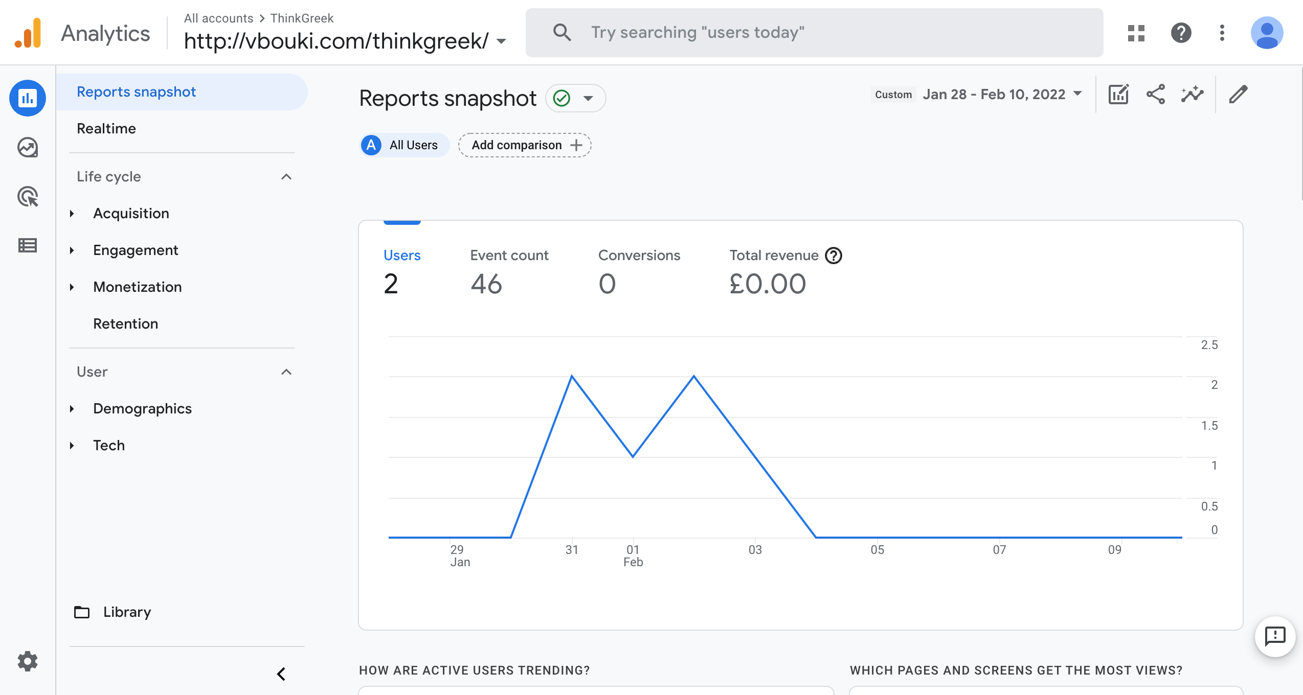
GA – general layout – actions
The account
Time
This is the “account locator” – slide 6
Edit comparisons
Share this report
Insights
Customize report
Admin

Slide 16
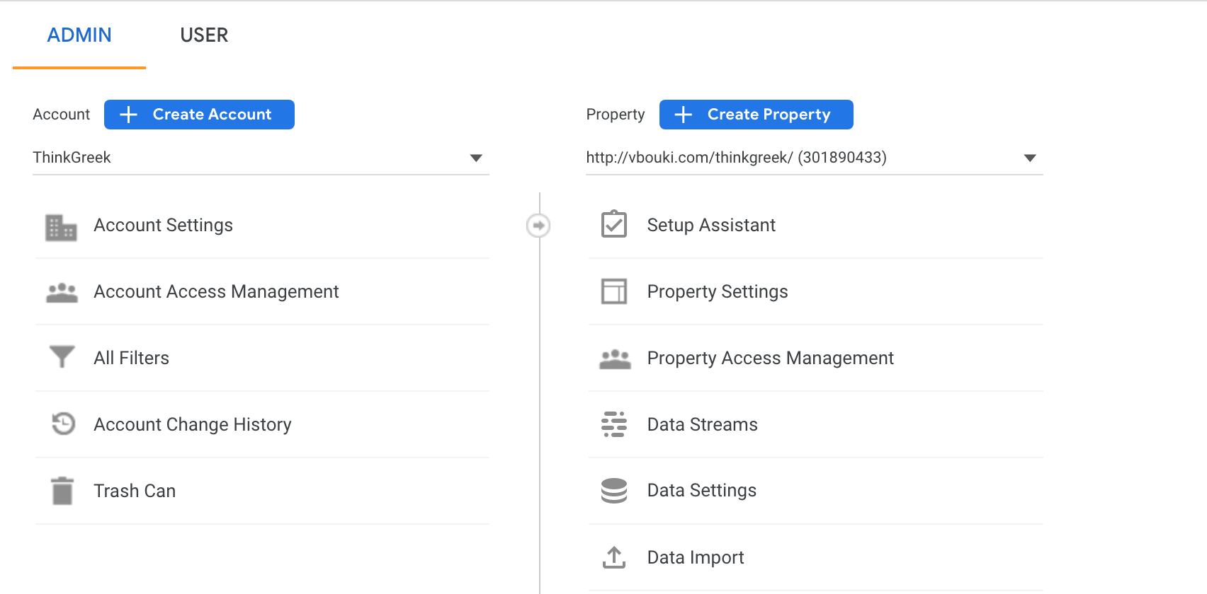
GA - Admin
Create account
Change / Select Account
Property with code
Create Property
In ‘Data Streams’ you can add streams and also get the tag/code

Slide 17
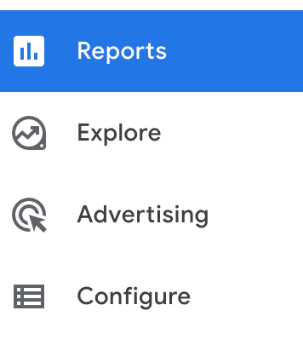
Google Analytics
We will focus on the REPORTS
After you have connected your site, you get a similar layout

Slide 18
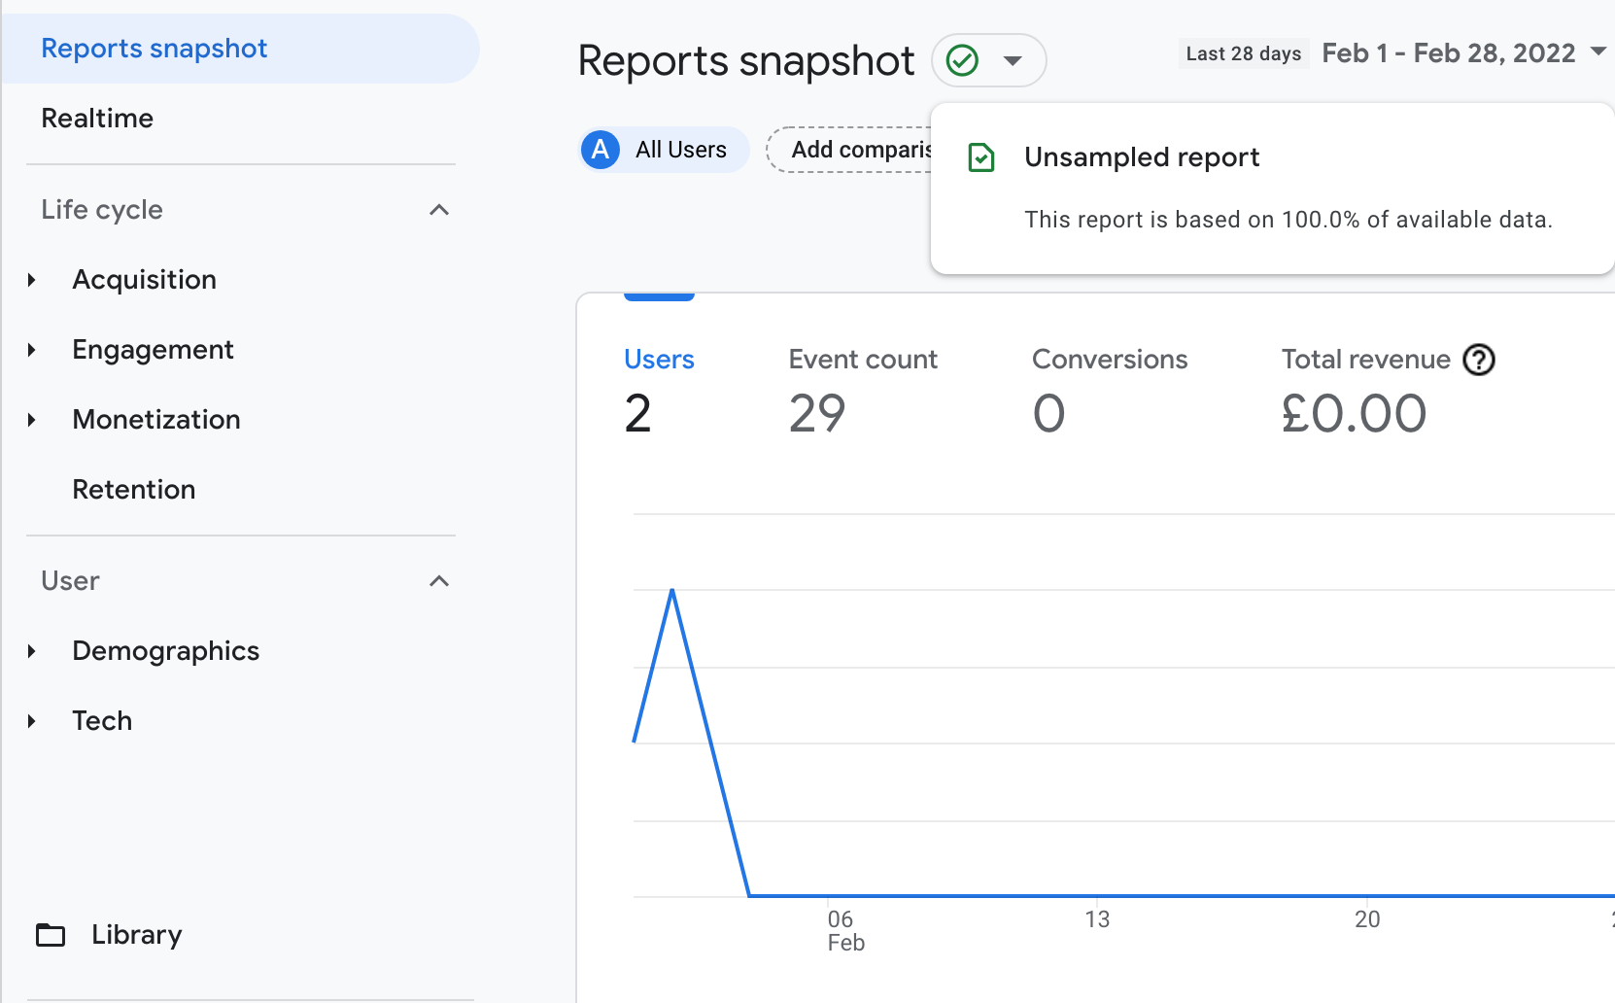
GA - Reports
Reports:
Reports snapshot
Unsampled report (we’ll return to this again next week)
Realtime

Slide 19
GA – Reports – Real Time
‘Real-Time’ allows you to monitor visitors’ activity as it happens on your site. Reports are updated continuously: each page view is reported seconds after it occurs.
You can see:
how many people are on your site right now,
their geographic locations and the traffic sources that referred them,
which pages or events they're interacting with,
With Real-Time, you can immediately and continuously monitor the effects of actions / policies on your traffic. Here are a few of the ways you might use Real-Time:
see whether a one-day promotion is driving traffic to your site or app, and which pages these visitors are viewing
monitor the immediate effects on traffic from a blog/social network post or tweet
verify that the tracking code is working on your site or app
A user is active if s/he has triggered an event or pageview within the past 5 minutes

Slide 20
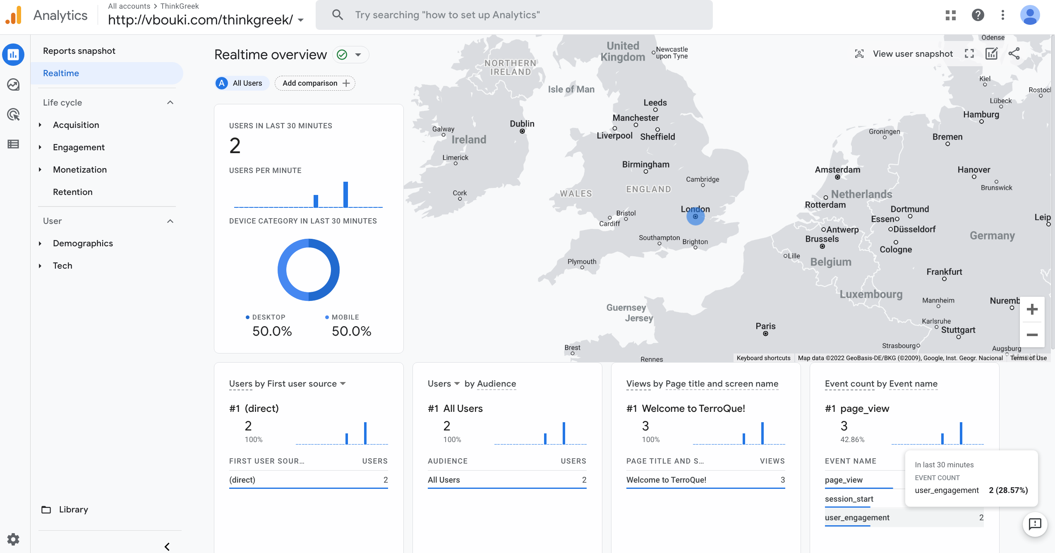
GA – Reports – Real Time
Example of “real time” report.
Use “real time” to confirm you have correctly connected your site with Google Analytics

Slide 21
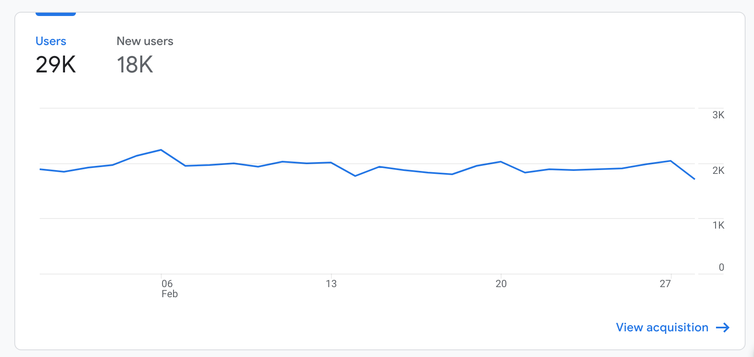
GA – Reports
The above is a very basic report.
It tells us how many users and new users visited the site during the period of one month. This is just one, basic metric.
This is very basic and not very useful.
In order to get a better understanding we need more information
Two types of data are represented in Google Analytics reports, dimensions and metrics.

Slide 22
GA – Reports – Dimensions
Dimension
“Dimension” is one of two types of data that makes up reports in Google Analytics.
A dimension is a descriptive attribute or characteristic of your users and their interactions with your website. E.g. a geographical location could have as dimensions: country, city name. Values for ‘city name’ dimension could be: London, Paris etc.
Dimensions are text strings that describe an item. Think of them as names.
Dimensions are typically presented as a row of information in reports.
You’ll find the dimension presented in the first column inside the standard Google Analytics reports.
Primary & secondary dimensions: in order to get more detailed data we are allowed to select a secondary dimension – this increases the rows in the report (eg Country and City).

Slide 23
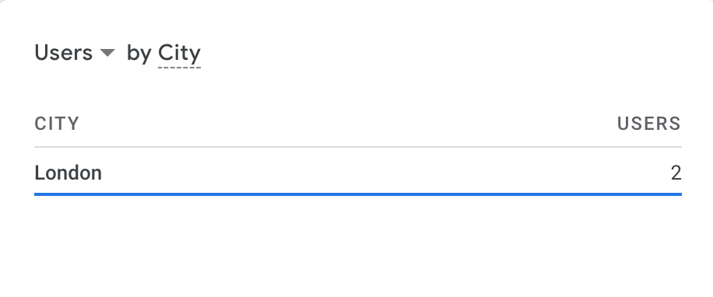
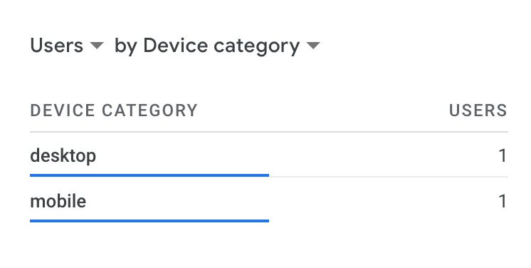
GA – Reports – Dimensions
For example:
The city by which users accessed my site
OR
The device users used to access my site

Slide 24
GA – Reports – Metric
The other type of data in Google Analytics reports is: metric.
Metric: individual elements of a dimension which can be measured.
A metric is typically a number, like a count, percentage, or ratio; metrics are the numbers associated with a dimension.
For example, the dimension City can be associated with a metrics like Population, which would have a sum value of all the residents of the specific city.
In GA, examples of metrics include page views, which tell you the total number of pages viewed and total users, which tell you how many people visited your website. Other example: engagement time.
Metrics are typically presented as columns of data in reports.

Slide 25
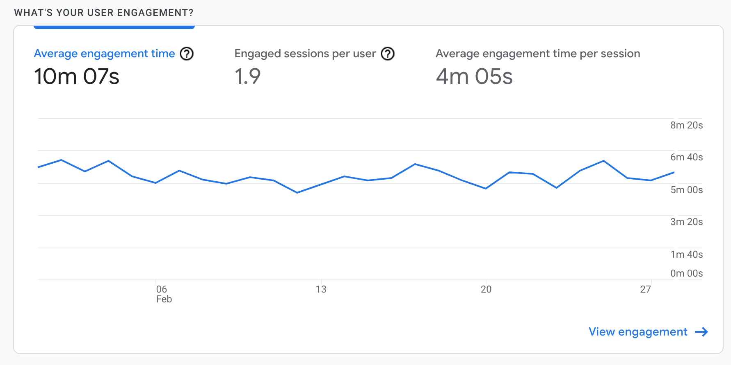
GA – Reports – Metric
For example:
Average Engagement time (per active user)
OR
Average engagement time per session

Slide 26
GA – Reports
In the following address from Google Analytics Support, you can find all “Dimensions and metrics in Google Analytics 4”
https://support.google.com/analytics/answer/9143382?hl=en
From the above page, you could access the “GA4 Dimensions & Metrics Explorer” (for more advanced users)
https://ga-dev-tools.web.app/ga4/dimensions-metrics-explorer/

Slide 27
Next week
This week we described how to connect your web site to Google Analytics; we discussed the basic terminology; we went through the main interface of Google Analytics and finally we discussed “metrics” and “dimensions”
Next week we will discuss the reports we create with Google Analytics, how we could create them and what they mean.

